Slide 1

Retail Sales Prediction
By
Ashwini R
Dhanaraj S
Data Science Trainee, Alma Better

Slide 2
Content
Problem Statement
Data Summary
Data Preprocessing
Exploratory Data Analysis
Feature Engineering
Model Implementation
Conclusion

Slide 3
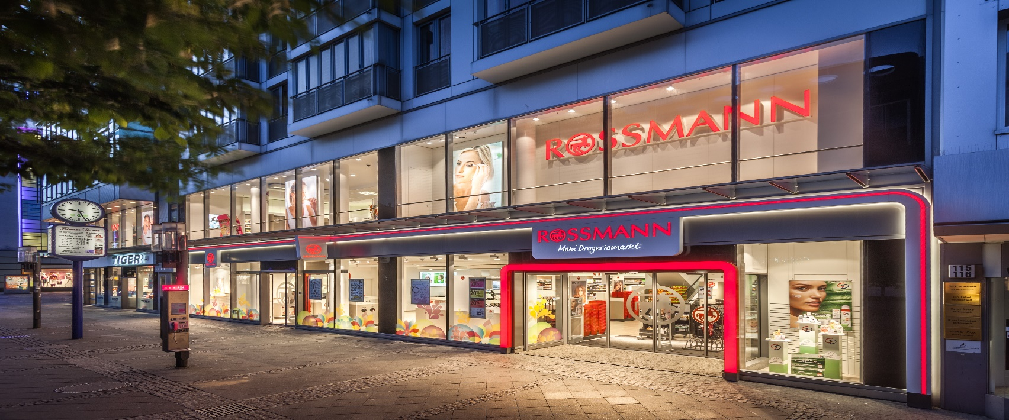
Problem Statement
Rossmann runs a network of more than 3000 pharmacies across seven European nations.
Given historical sales data for 1,115 Rossmann stores, the sales figures are affected by numerous factors. The objective is to predict the "Sales" for the upcoming six weeks.

Slide 4




Data Summary
We possess two datasets. The Rossman store data covers the years 2013, 2014, and 2015, comprising 10,17,209 observations across 9 variables. The Stores data consists of 1115 observations involving 10 variables. Some notable features include:
Customer : - The quantity of patrons in a store on a specific day.
Date :- Showing dates for observations.
State Holiday :- Indicating a state holiday.
Store Type : Differentiate between 4 different store models (a,b,c,d).
Assortment : Describes an assortment level i.e a : basic, b : extra and
c : extended.
Competition Distance : Distance in meters to the nearest competition store.
Promo :- Indicates whether a store is running a promo on that day.

Slide 5
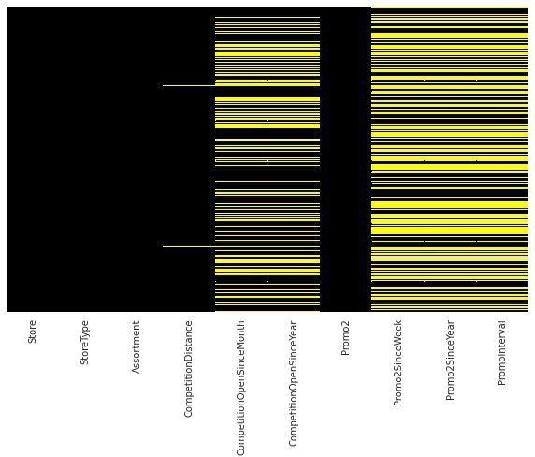
Data Preprocessing
Columns having >30% null
values are dropped.
Null values in ‘Competition Distance’ are imputed with median of feature.
Removing those stores observations that are temporarily closed (~ 17.3K) & stores generating zero sales.

Slide 6
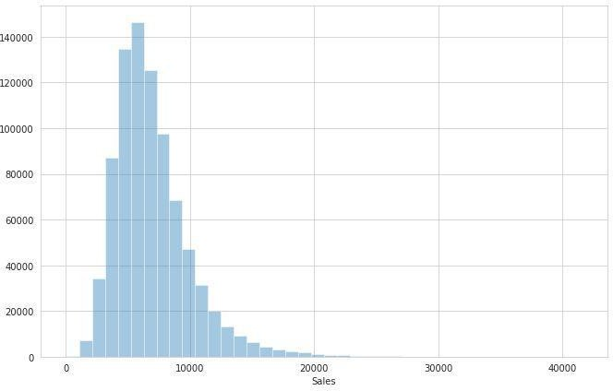
Exploratory Data Analysis
Sales are normally distributed with slightly right tail skewed.

Slide 7
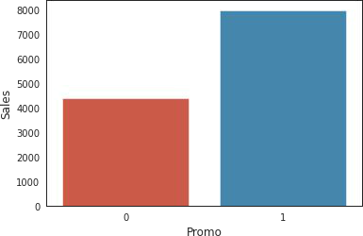
EDA (contd..)
Impact of Promo on sales

Slide 8
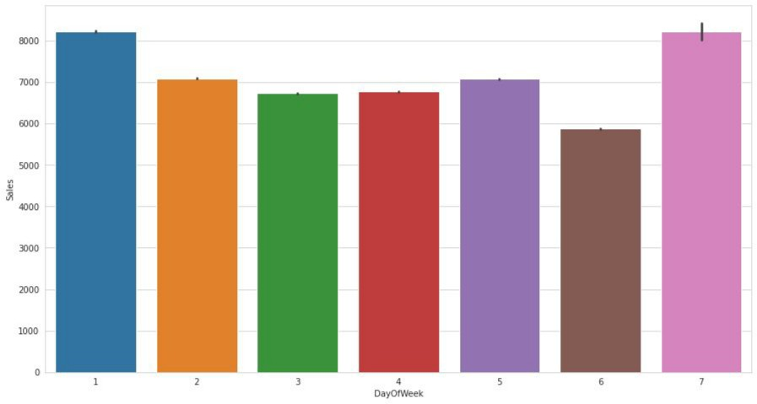
EDA (contd..)
Day Wise trends in Sales

Slide 9
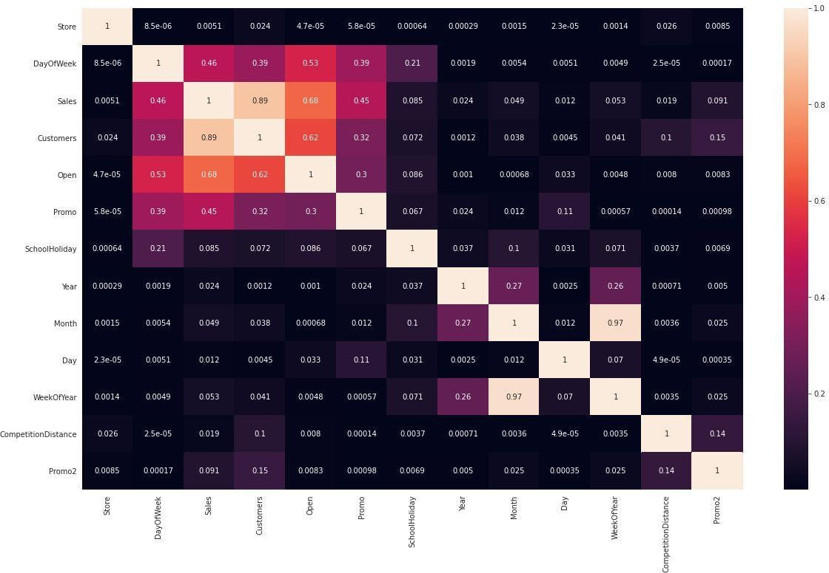
EDA (contd..)
Heatmap for merged dataset

Slide 10
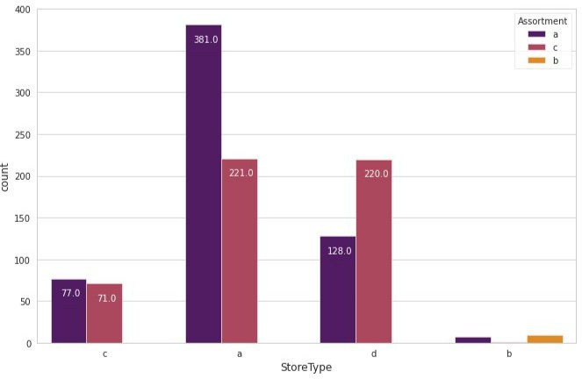
EDA (contd..)
Analysis of Store Types with their respective assortment.

Slide 11
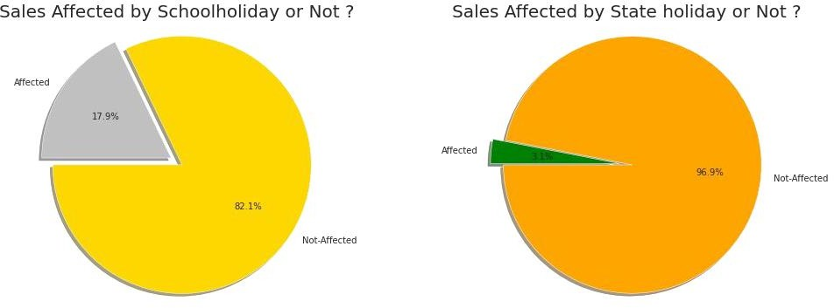
EDA (contd..)
School and State holidays effect on sales

Slide 12
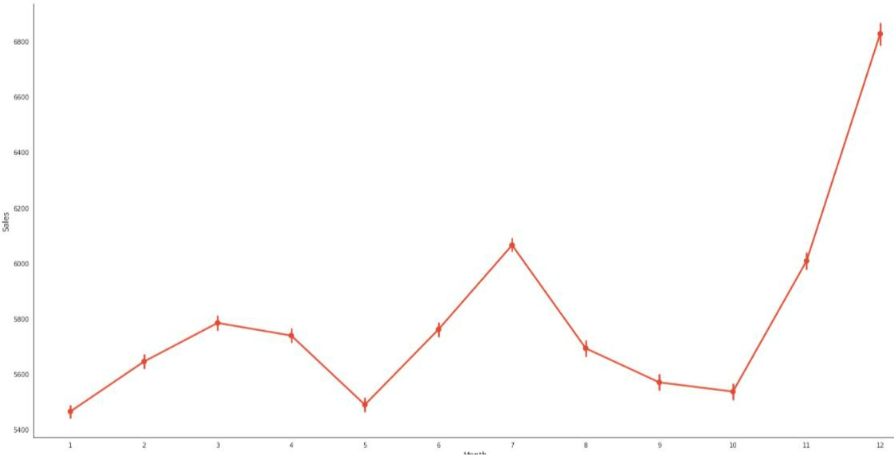
EDA (contd..)
Monthly trends in Sales

Slide 13
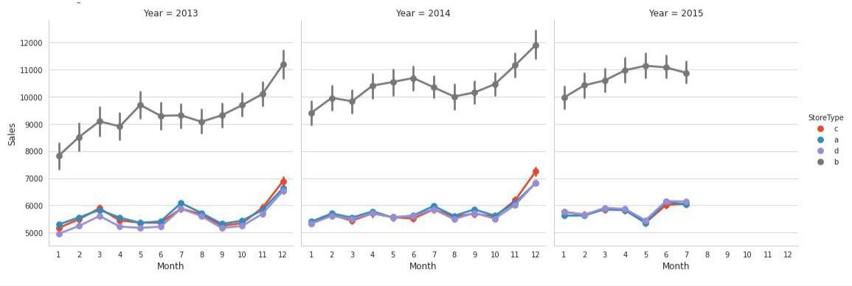
EDA (contd..)
Yearly Distribution of Sales according to store types

Slide 14
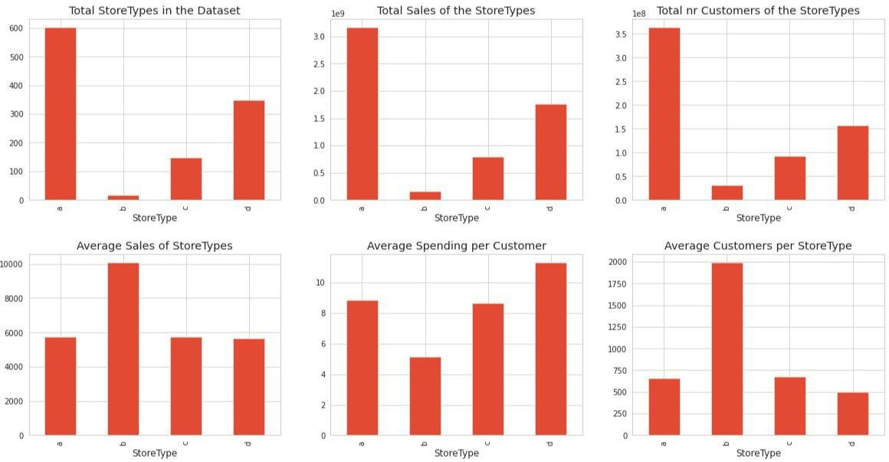
EDA (contd..)
Store Types and average sales/customer/spending relation

Slide 15
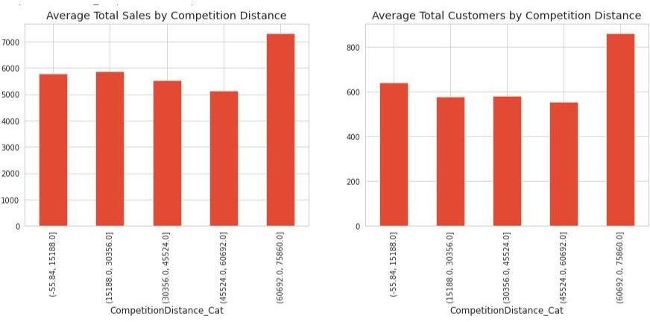
EDA (contd..)
Impact of Competition Distance on Sales and Customers

Slide 16
EDA (summary)
Sales are highly correlated to customers.
Stores opened on ‘State Holiday’ makes a good amount of sales.
There is no such significant difference in sales on ‘School Holidays’.
Even though store type ‘b’ has very less number of stores but these are outperforming other store types in
terms of sales and avg customers.
Sales are consistent for the second quarter of the year but
it starts increasing in the last quarter.

Slide 17
Feature Engineering
Extracting week, month, year from Date and adding them in dataset.
Merging both dataset.
One hot encoding for Storetype, Assortment.
Splitting dataset into Training and Test set and applying MinMaxScaler for scaling dataset.

Slide 18
Models Implemented
Linear Regression (Baseline Model)
Lasso Regression
Decision Tree Regression
Decision Tree Regression ( with hyperparameters)
K-Nearest Neighbors Regression
Random Forest Regressor

Slide 19
Model Evaluation
MODEL | TRAINING SCORE | TESTING SCORE
Linear Regression | 0.780750 | 0.782392
Lasso Regression | 0.780731 | 0.780769
Decision Tree | 0.99996 | 0.915942
Regression
Decision Tree | 0.963506 | 0.935417
Regression ( with
hyperparameters)
K-Nearest Neighbors | 0.73722 | 0.71665
Regression
Random Forest | 0.993783 | 0.956520
Regressor

Slide 20
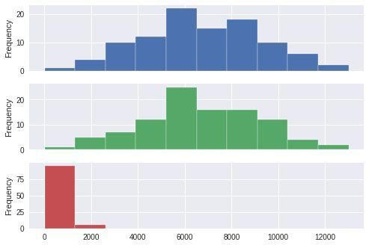
Insights from Random Forest Regressor
Predictions from random forest model are very close to actual values in our X dataset as we have good score. The figure shows actual values, predicted & the difference between them respectively.
Since this is Sales prediction MAE is a good metric.
We’re getting Mean Absolute Error ~ $
380 And MAPE of 5.65%

Slide 21
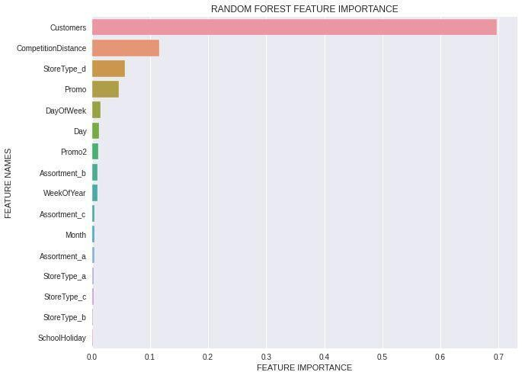
Feature Importance

Slide 22
Conclusion
Our model shows that Customers, Competition distance, Store type are some of the most important features in our sales prediction. We need to focus on these aspects to maximize our profits for the next 6 weeks.

Slide 23
Thank you

